Slide 1

Intro to (my view on) Lean and Kanban

Slide 2

Who am I?
Jon Terry, COO, LeanKit
After time in the Army and as a newspaper reporter and editor, Jon held a number of senior IT positions with hospital-giant HCA and its subsidiary HealthTrust Purchasing Group. He was a key leader in HCA’s widespread adoption of Lean/Agile methods. Jon earned his Global Executive MBA from Georgetown University and ESADE Business School in Barcelona, Spain. He is a Project Management Professional.

Slide 3

Traditional “waterfall” planning depends on predicting the future
18+ months?!
Requirements
Design
Develop
Test
But change is a given. We can’t control it.
Plan for bad changes. Embrace good ones
Enterprise Kanban

Slide 4
“Lean” is replacing it. First in factories, now front offices
60’s-80’s
80’s
90’s
2000’s
Today
Lean Healthcare
TQM
TOC
Lean Manufacturing
Toyota
Production System
Lean Construction
Just-In-Time
Six Sigma
Lean Marketing
Focus is on rapid system flow and feedback, versus planning and “efficiency”
Enterprise Kanban

Slide 5



Agile IT is part of the same movement
60’s-80’s
80’s
90’s
2000’s
Today
Lean Healthcare
TQM
TOC
Lean Manufacturing
Toyota
Production System
Lean Enterprise
Just-In-Time
Six Sigma
Lean Software Development
Agile
Scrum
XP
Kanban
Enterprise Kanban
Notes:
Adoption of Lean principles helps connect Agile at the team level to organizational priorities and processes. It “sells” well to senior executives because it helps relate Agile to very successful practices in other industries.

Slide 6
Principles from Lean industry map well to IT environment
Extra Features
Work-In-Process
Technical Debt
Handoffs
Task Switching
Delays
Defects
Optimize the Whole
Respect People
Deliver Fast
Defer Commitment
Create Knowledge
Build Quality In
Eliminate Waste
Lean PD System
Skilled People
Tools & Technology
Process
Notes:
Eliminate Waste – Waste is defined from your end customer’s perspective. Anything they wouldn’t pay for should be reduced or eliminated.
Extra Features – Research shows that roughly 60% of features in custom software are rarely or never used. But every time new features are added to a system those old, unused features must be considered in the design, coded around, and regression tested. They have no value but they add cost.
Work-in-Process – Partially completed IT work loses value the longer it waits for completion. For example, if a developer asks an analyst a question about a specification he wrote a month ago, the analyst often has to go back to the customer for clarification. If you can design, build, test and deploy in small increments this rework isn’t required.

Slide 7
Principles from Lean industry map well to IT environment
Extra Features
Work-In-Process
Technical Debt
Handoffs
Task Switching
Delays
Defects
Optimize the Whole
Respect People
Deliver Fast
Defer Commitment
Create Knowledge
Build Quality In
Eliminate Waste
Lean PD System
Skilled People
Tools & Technology
Process
Notes:
Eliminate Waste – Waste is defined from your end customer’s perspective. Anything they wouldn’t pay for should be reduced or eliminated.
Technical Debt - We sometimes take on financial debt to buy something that is more valuable to us now than later. In product development, it can be necessary to cut corners to deliver quickly because the value of the new features is time sensitive. In both cases, we have to pay back the principal and interest. In the case of the technical debt, the interest is rework to fix both the lower quality code and anything that has been built on top of it since then.
Handoffs – It is impossible for anyone to document everything they know about something. And a reader can never extract from a document the full meaning that the writer intended. A typical waterfall project includes a lot of documentation, each successive document supposedly adapting the previous ones for use in the next step in the process. Customer Intent - Requirements – Design Specification – Code – Test Cases – Training Manuals – Finished Product. Given the time lag involved, it should not be surprising that the finished product often bears little resemblance to the customer intent. Better to organize and maintain cross functional teams that can work closely with a customer to quickly discover and develop what’s needed with the minimum non-value added documentations.

Slide 8
Principles from Lean industry map well to IT environment
Extra Features
Work-In-Process
Technical Debt
Handoffs
Task Switching
Delays
Defects
Optimize the Whole
Respect People
Deliver Fast
Defer Commitment
Create Knowledge
Build Quality In
Eliminate Waste
Lean PD System
Skilled People
Tools & Technology
Process
Notes:
Eliminate Waste – Waste is defined from your end customer’s perspective. Anything they wouldn’t pay for should be reduced or eliminated.
Task switching – It is impossible for a human to think about more than two things at once and then only if the two thoughts use different parts of the brain. I can read and listen to music. But I cannot read and watch television with dialogue. In fact, what we mostly do is task switch rather than multi-task. And each time we switch back and forth between activities, we lose information. We forget where we were in the documentation. We forget why we made a particular design decision. We fail to correct a coding mistake that we made the last time we were working on something and were pulled away and must go back later and fix it. The more tasks that are on our plate at a time, the less of our time is actually adding value and the more is consumed by these switching costs. A developer assigned to three or more projects is spending more time on context switching than actual productive work.
Delays – There is a cost to delay. As mentioned before, work that stalls while in process loses value and requires rework. It also loses value from the end customer’s perspective. A new feature that is a market differentiator if delivered quickly becomes a commodity if delivered behind competitors and may become a problem if delivered too late. Think of Apple iOS versus Android versus Windows 7 Phone.
Defects – This one seems obvious. That’s why IT departments have QA testers. But, in Lean industry, they long ago stopped relying on end-of-the-line testing to find product defects. Instead, they work continuously to learn WHY defects arise and adjust production techniques to avoid them in the first place.

Slide 9
Principles from Lean industry map well to IT environment
Extra Features
Work-In-Process
Technical Debt
Handoffs
Task Switching
Delays
Defects
Optimize the Whole
Respect People
Deliver Fast
Defer Commitment
Create Knowledge
Build Quality In
Eliminate Waste
Lean PD System
Skilled People
Tools & Technology
Process
Notes:
Build Quality In – In order to avoid creating defects rather than rely on testers finding them we must implement test driven development with as close to 100% unit test coverage as possible, automated functional regression testing, continuous integration, and automated deployment. This has upfront costs and seems to decrease delivery speed but it is the only way to maintain speed and high quality in the long run.

Slide 10
Principles from Lean industry map well to IT environment
Extra Features
Work-In-Process
Technical Debt
Handoffs
Task Switching
Delays
Defects
Optimize the Whole
Respect People
Deliver Fast
Defer Commitment
Create Knowledge
Build Quality In
Eliminate Waste
Lean PD System
Skilled People
Tools & Technology
Process
Notes:
Create Knowledge – We only truly gain knowledge by doing something and, as discussed above, we can never full document what we know. So, rather than documenting at length, we should focus on quickly building working products and getting them in the hands of customers for feedback. Rather than building all of the features what we believe our product will eventually include, we should narrow this down to a Minimum Marketable Feature set – the least complex working product that still has value to the customer. We then build incrementally on that MMF to develop the final product, which may bear little resemblance to our original conception. This change is good because the final feature set is driven by customer interaction with a working product that they can really understand and not documentation and design specs based on conjecture.

Slide 11
Principles from Lean industry map well to IT environment
Extra Features
Work-In-Process
Technical Debt
Handoffs
Task Switching
Delays
Defects
Optimize the Whole
Respect People
Deliver Fast
Defer Commitment
Create Knowledge
Build Quality In
Eliminate Waste
Lean PD System
Skilled People
Tools & Technology
Process
Notes:
Defer Commitment – When making major, irrevocable decisions, wait until the last responsible moment. If at all possible, develop multiple parallel options to see which one will work before committing. This may seem to add cost in the short run but it avoids the risk of major failure later when sunk costs are larger and more painful/impossible to write-off.

Slide 12
Principles from Lean industry map well to IT environment
Extra Features
Work-In-Process
Technical Debt
Handoffs
Task Switching
Delays
Defects
Optimize the Whole
Respect People
Deliver Fast
Defer Commitment
Create Knowledge
Build Quality In
Eliminate Waste
Lean PD System
Skilled People
Tools & Technology
Process
Notes:
Deliver Fast – Produce a working product before your customers or the market change their minds. If the product is a failure you can cancel further production sooner rather than later. Your failures will be small learning experiences rather than large catastrophes. Work should be prioritized by the cost of delay

Slide 13
Principles from Lean industry map well to IT environment
Extra Features
Work-In-Process
Technical Debt
Handoffs
Task Switching
Delays
Defects
Optimize the Whole
Respect People
Deliver Fast
Defer Commitment
Create Knowledge
Build Quality In
Eliminate Waste
Lean PD System
Skilled People
Tools & Technology
Process
Notes:
Respect People – An IT organization is fundamentally an organizer of human brainpower and creativity. Those humans are drastically more productive when they understand the priority of various organizational goals, are excited about those goals, engaged in the decisions about how to reach those goals, placed in a position to steadily deliver on achievable milestones toward the goals, and working around people whom they like and respect. Treat them like interchangeable “resources” and the best ones will leave, the decent ones will shut down and management will be left babysitting the least productive.

Slide 14
Principles from Lean industry map well to IT environment
Extra Features
Work-In-Process
Technical Debt
Handoffs
Task Switching
Delays
Defects
Optimize the Whole
Respect People
Deliver Fast
Defer Commitment
Create Knowledge
Build Quality In
Eliminate Waste
Lean PD System
Skilled People
Tools & Technology
Process
Notes:
Optimize the Whole – The goal of a Lean organization is to improve throughput though the whole system not to achieve productivity improvements in specific departments. When looked at from a systems perspective, local efficiencies may in fact slow down the overall flow. That flow is driven primarily by whatever step in your process is the bottleneck – your slowest function. You need slack capacity in the other functions up and downstream from that function in order to ensure that the bottleneck is kept as productive as possible. Middle managers must be prevented from keeping people busy. Slack time should be used for process improvement.

Slide 15
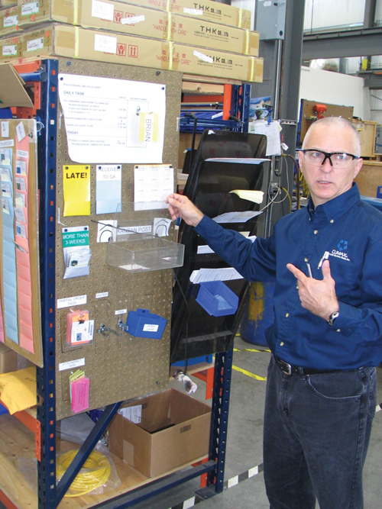
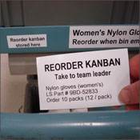
Kanban is Japanese for visual card Allows decentralized decision making
Set priorities, not schedules
Enterprise Kanban
Notes:
In a manufacturing or logistics setting, kanban is used to tell people at a given work station when to do work of certain type based on visual signals sent by other workers in downstream steps of the overall process.
For example, a worker on an production line might have a bin of parts that he uses as inputs to his step in the process. Once his parts bin gets to a predetermined level, he will come to a kanban card telling him to order more. He will hang that card up in a visible location. That tells the person who makes those parts to start making more. New parts are made just-in-time because in-process inventory is waste. It takes up space. It consumes processing time unnecessarily. It becomes obsolete.
We want to have just enough inventory in the system to buffer against variations in demand

Slide 16
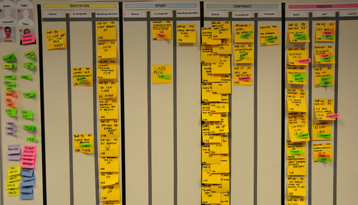
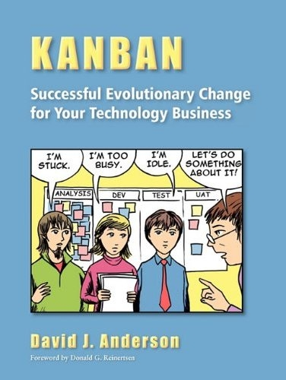
For knowledge workers, Kanban has come to mean Post-ItTM
bottlenecks
Visualizing work provides immediate insight into flow (or not)
Enterprise Kanban
Notes:
On a kanban board, the steps in a team’s process are mapped out as (typically) left-to-right lanes on a whiteboard, wall or window. Marker lines (usually replaced later by tape) separate the lanes. Sticky notes or 3x5 cards represent work items moving through the process flow. Smaller sticky notes (the sort you use to mark where to sign a document) are used to draw attention to specific cards, indicating who’s assigned, specific due dates when truly necessary, priority, blockages, etc.
Despite my screenshots, a well designed kanban board uses color to draw attention to cards that matter. For example, you might use green to indicate good cards (those that add value), red to indicate bad cards (work that fixes problems but doesn’t add new value), and yellow to indicate work done to mitigate risks. That’s just an example. The key is draw the eye to the cards that deserve attention by other team members and by management.
You don’t have to be able to read the cards on a kanban board to recognize what’s happening. A column that’s jammed full of cards is obviously a bottleneck. Rather than continuing to work on their normal tasks, teams should be trained to “swarm” on the bottleneck – providing whatever help they can to that person or team. At the very least, they should stop piling up work in front of the bottleneck. There’s no value in generating more partially complete work when the system is jammed.

Slide 17
For knowledge workers, Kanban has come to mean Post-ItTM
But sticky notes don’t scale, work for distributed teams, or track metrics
Enterprise Kanban
Notes:
So far, this could also describe the sort of card wall that many Scrum teams use to manage work during an iteration. A few key things distinguish a kanban board.
Scrum card walls are typically limited to To Do, Doing, Done. Kanban boards map out all of the main steps that a team normally takes in doing their work. Unless individual workers do all the work on a story without hand-offs, then even a Scrum sprint is really a mini-waterfall of sequential steps. The kanban board represents this reality.
For any given main step in the process (Requirements, Design, Develop, etc.), a kanban board should have at least 2 sub-lanes: one for work that is truly in process and the other as a holding queue. Workers in one step of a process cannot put work into the in process lane for the next step down the line. All they can do is put it in a waiting queue indicating that they are done and that next team can “pull the work” when they are ready.
To turn a card wall into a true kanban system like in manufacturing, you have to implement Work-In-Process limits
Little’s Law and queuing theory show that any system will slow down dramatically at roughly 60-70% of resource utilization. Trying to maximize resource utilization actually results in drastically less output.
Putting explicit limits on WIP (Work in Process) is designed to prevent over-utilization. Limiting WIP tends to measurably increase output and decrease variability.

Slide 18
The Kanban Method
Visualize the workflow
Limit Work-in-Progress
Manage Flow
Make Process Policies Explicit
Improve Collaboratively using models and the scientific method
Enterprise Kanban
Notes:
This is just common sense, seriously:
Seeing helps understanding, especially among members of a group
Focusing on fewer things gets more work done in the long run and helps us do a better job on each one
As managers, we should focus our efforts on ensuring that high quality work flows smoothly through our system – not on micromanaging the individual tasks
Storing “the rules” about how work should be done in a process library is a great to be sure they are ignored. Building them into your board so that people are encouraged to do things the right way because the correct steps are mapped as lanes or written next to lanes is much more effective. As rules change, the board should, too.
Kanban is a technique for continuous process improvement. You should never stop at your first version. The team should continually review their results and use that learning to update their process/board. And ideally, they should do so with reference to Lean principles and other good management ideas. Every team has context specific needs but there are a lot of great ideas out there.

Slide 19
Agile means iterative planning not necessarily fixed releases
Product Backlog
Release Planning
Release Backlog
Ideas
Fixed Time and Resource
Iteration 1
Iteration Planning
Daily Standup
Ops Review
Iteration Planning
Daily Standup
Ops Review
Iteration n
Release 1
Iteration Backlog
Not Done
Iteration Backlog
Not Done
Scrum vs Kanban
Enterprise Kanban
Notes:
Waterfall planning determines scope first then plans a schedule to fit.
Lean / Agile planning develops a regular delivery cadence, breaks work down into the smallest-possible deliverable increments and then makes continuous priority decisions about what makes sense to do next. The non-critical work will somehow never rise to the top.
The primary difference between Scrum and Kanban in an iterative sense, is that kanban decouples the planning cycle from the technical release cycle. Stand-ups will still be done daily. Backlog reviews, customer demo’s and retrospectives may still be done bi-weekly or monthly. But product releases will be done as often as engineering practices and customer capacity to accept change will allow.

Slide 20
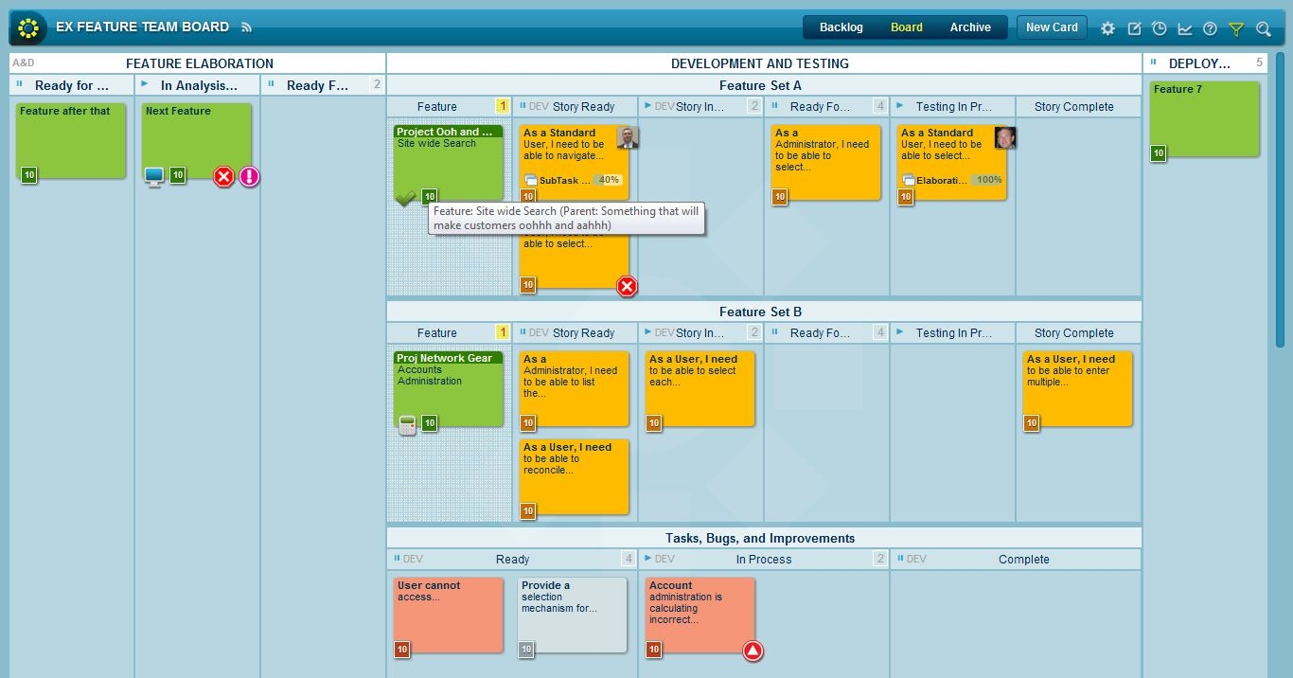

Electronic systems like LeanKit support scaling, distribution
For other options
Enterprise Kanban

Slide 21
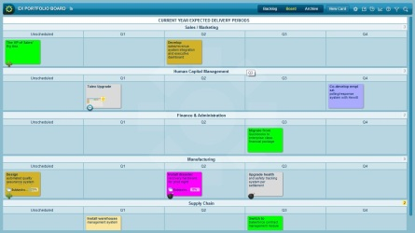
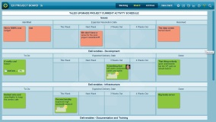
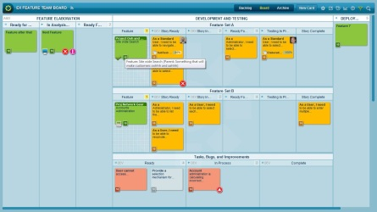

Multi-level Kanban Supports Scaling
Enterprise Portfolio
Cards:
Vertical Lanes:
Swimlanes:
For:
Key Projects
Quarters
Lines of Business
CIO & Peers
Road Map
Project Breakdown
Cards:
Vertical Lanes:
Swimlanes:
For:
Deliverables
Months
Functions
Project Leads
Project A
Project B
Project C
Project Z
Departments
Cards:
Swimlanes:
For:
Operations
or User Stories
Process
Team Members
Development
Infrastructure
QA
API Integration
Link to multiple systems
Source Control
Change Mgmt
Test Planning
Enterprise Kanban

Slide 22
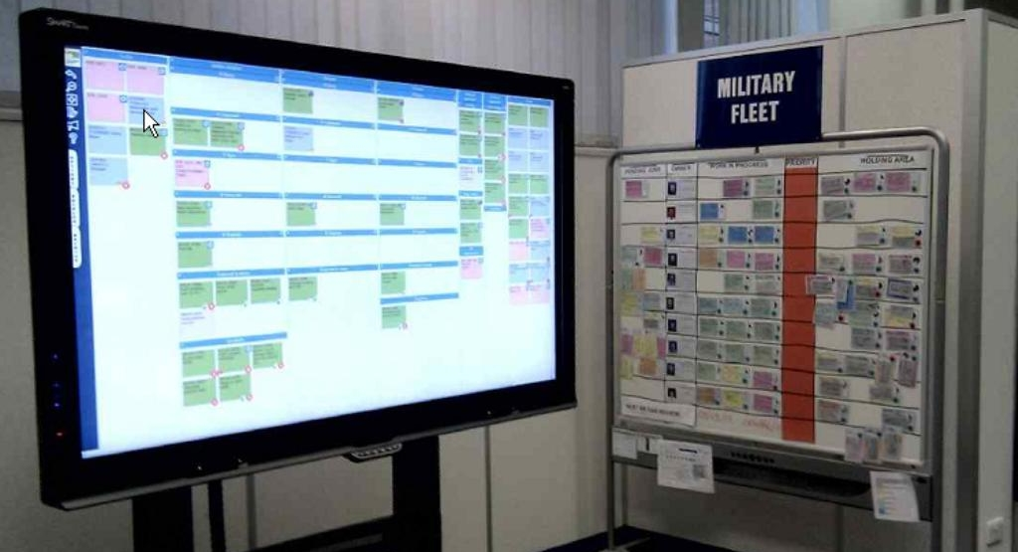
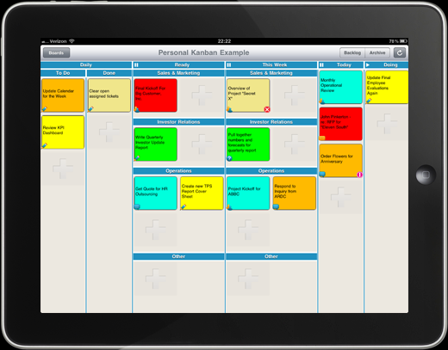
Electronic Kanban doesn’t have to mean hidden on your computer
Enterprise Kanban

Slide 23
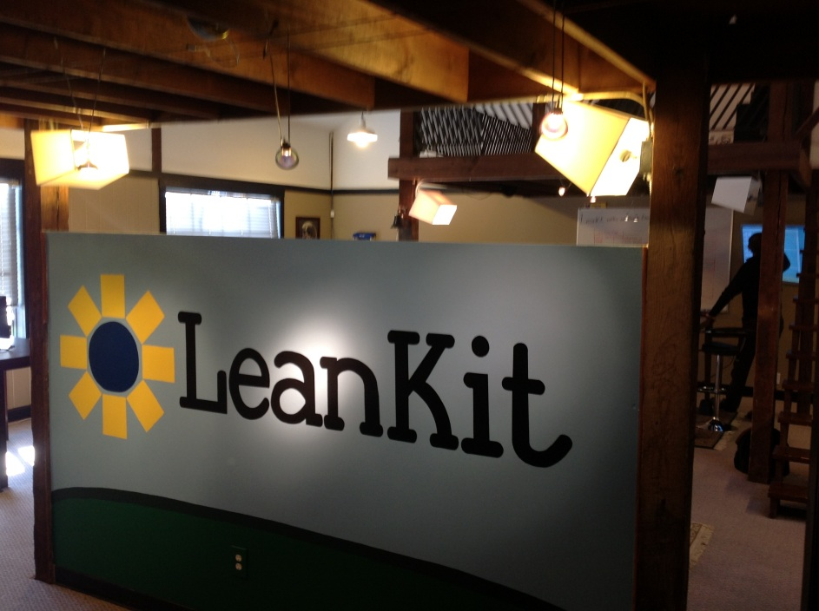
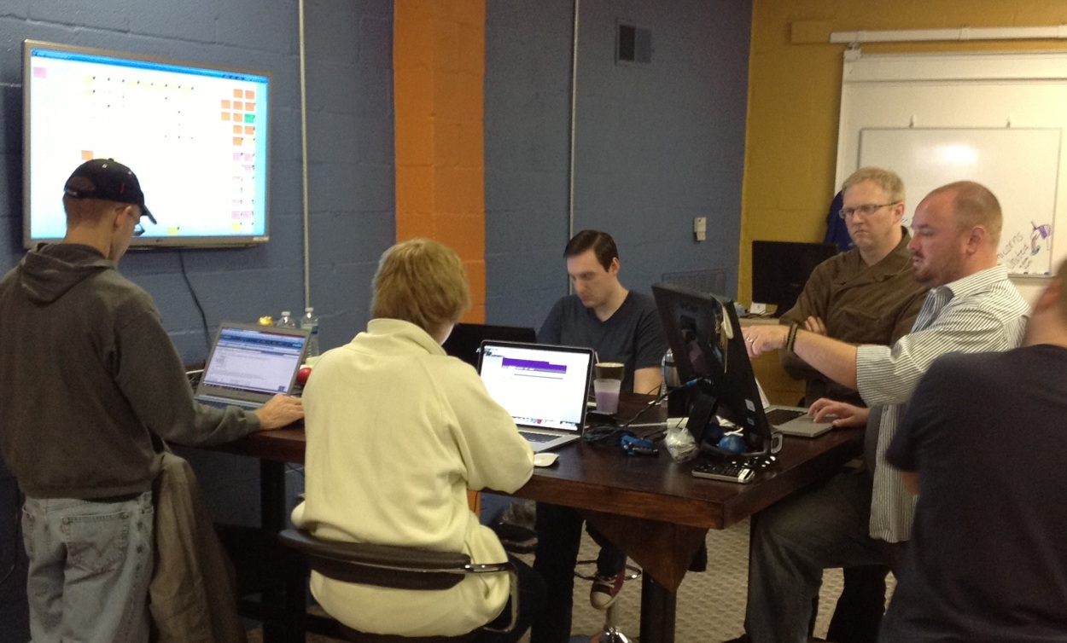
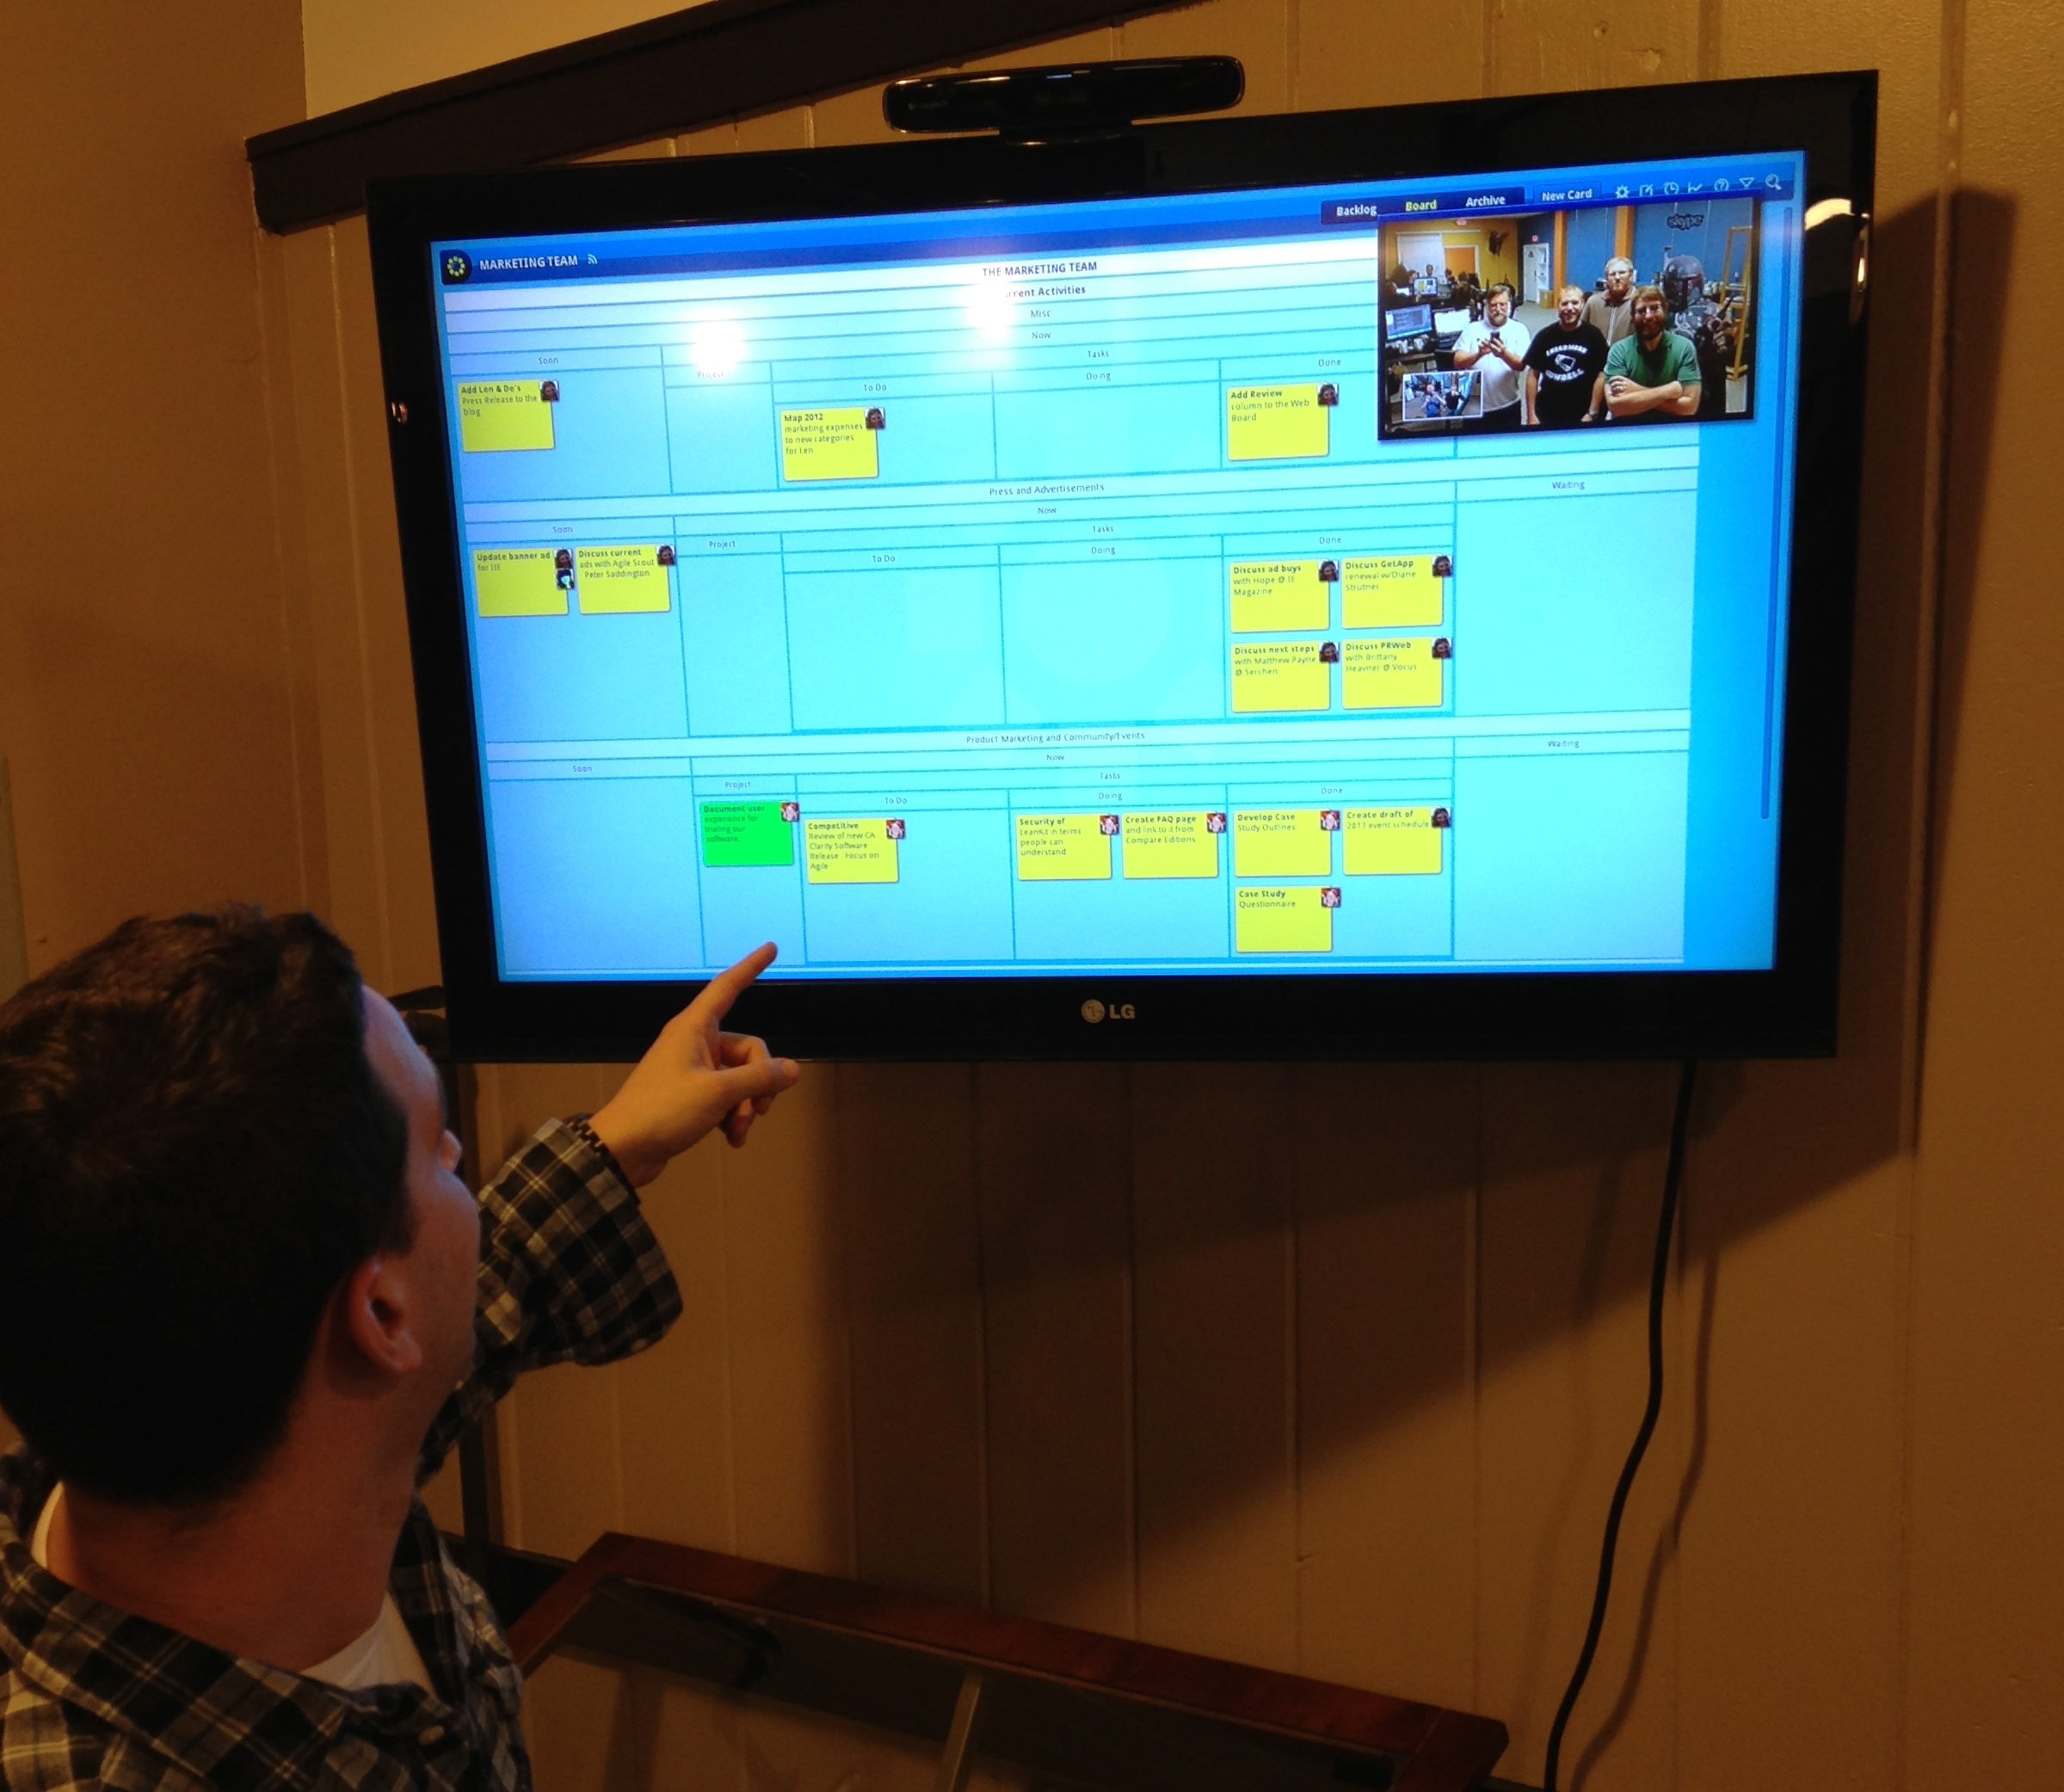
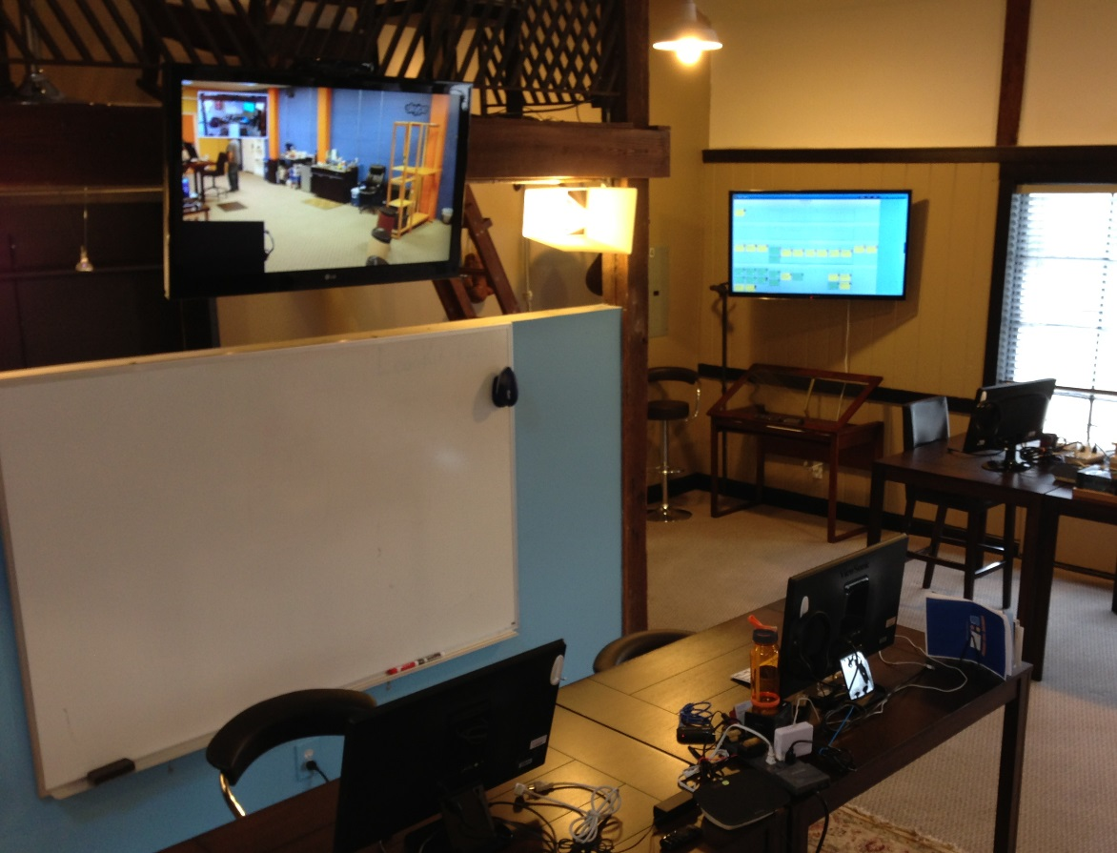

Slide 24
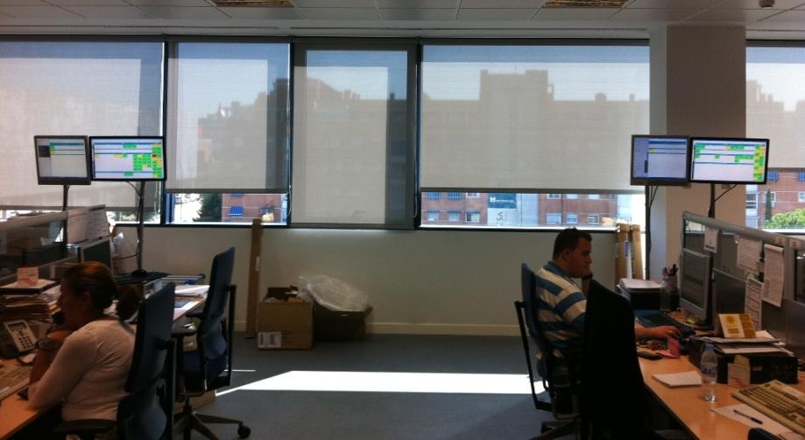
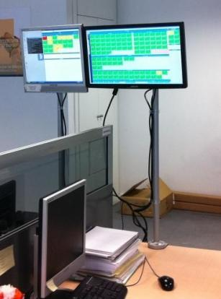
BBVA – Madrid, Spain
Improved Response Time by 79%
Improved Resolution Time on High Priority Items by 31%

Slide 25
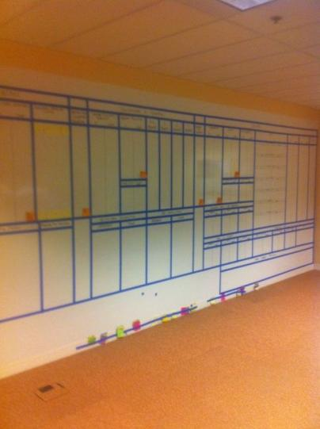
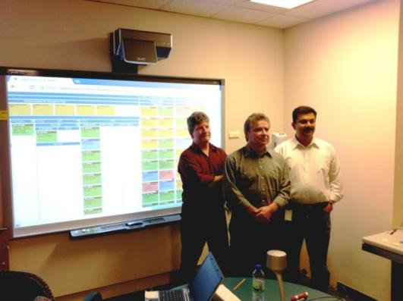


Ontario, Canada

Slide 26
Thank You!
More about LeanKit & Lean
www.LeanKit.com
Be sure to check the blog

Slide 27
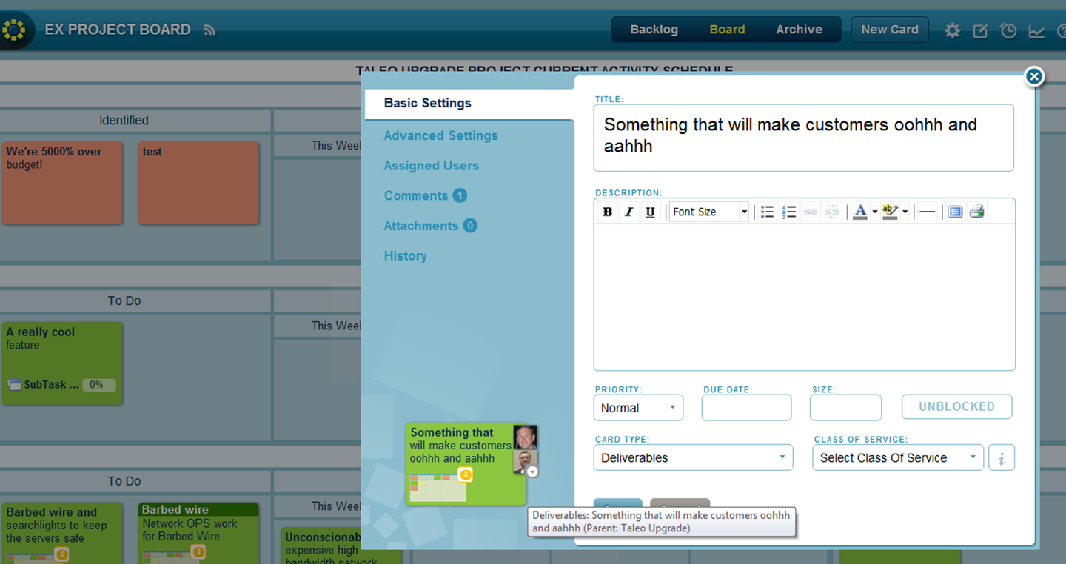
“Back” of cards store additional info, comments, history, & attachments
Enterprise Kanban

Slide 28
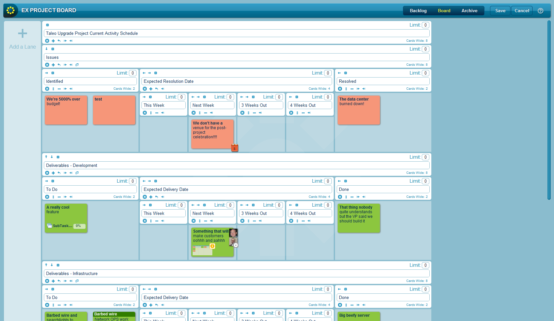
Visual editor can model any process Template library stores best practices
Enterprise Kanban

Slide 29
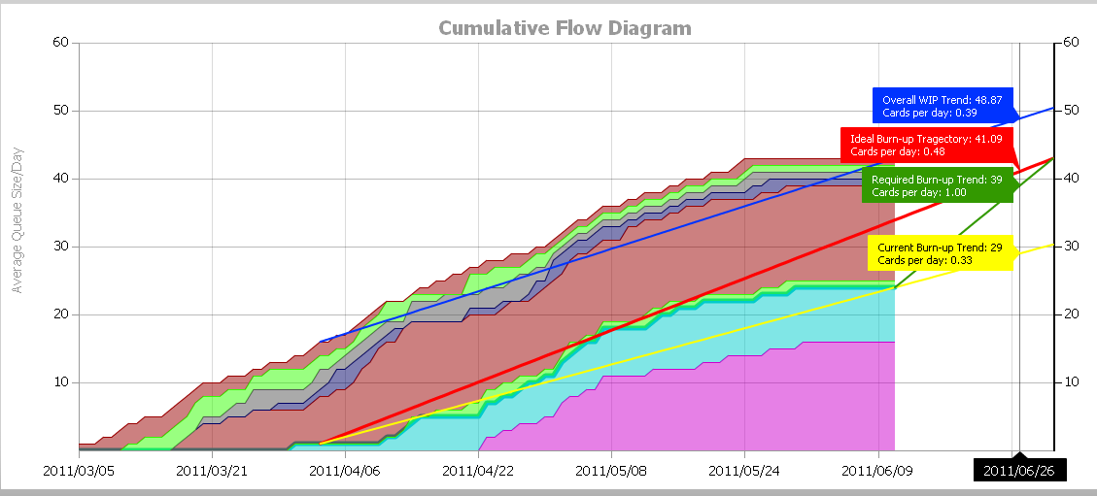
Cumulative flow shows bottlenecks Burn-up tests deadline feasibility
Not based on estimates or percent complete – just card moves
Enterprise Kanban
Notes:
Cumulative flow diagram shows where bottlenecks are forming in a process. Think of it as the board turned on its side. Each color represents a lane. The height of the colors represents how many cards were in the lane at a point in time. If one lane is getting taller and the others aren’t, you have a bottleneck.
Burn-up analysis allows you to use a team’s work history data to predict whether they can get current workload done a desired end date. The redline is your required productivity trend to hit a target. The yellow line is your actual trend. The green line is what must be done to hit the target. The steeper the green line, the less likely it is that you can recover.
The great thing about kanban analytics is that they are based simply on people moving sticky notes. That’s easy for them to do quickly so they actually do it. You get a picture of what’s actually happening rather than an estimate.

Slide 30
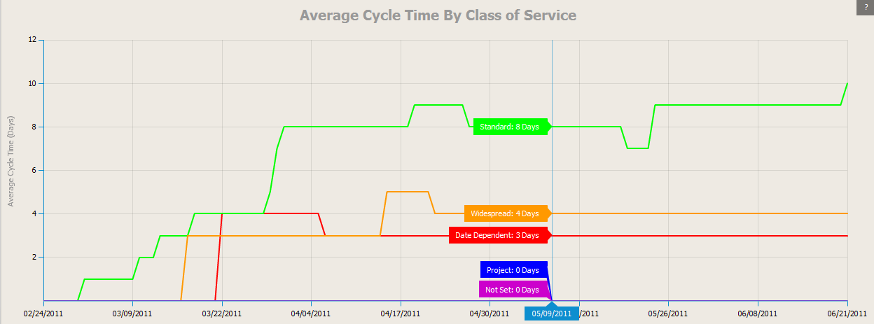
Measuring cycle time determines capability, establishes SLAs
In time, better decomposition & effective categorization can replace estimating
Enterprise Kanban

Slide 31
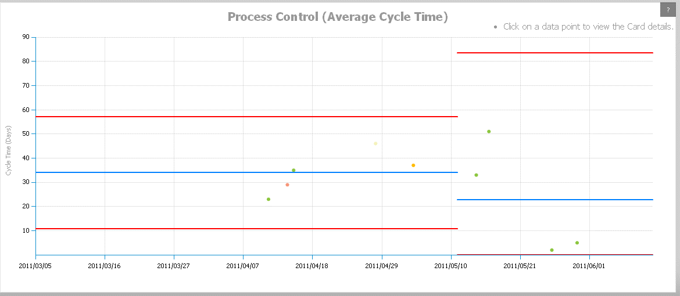
Being fast is great, but how reliable is your delivery? Do changes help?
Enterprise Kanban
Notes:
Process control charts let you see your average delivery speed (the blue line) and your confidence interval – your upper and lower 3 sigma bounds (red lines) within which 98% of your results fall. You can insert a control point to see what your process looked like before and after a major change (like adding more people, re-engineering a process, etc.)
Tighter redlines mean a less variable and more predictable process. You can use results data to set Service Level Agreements (SLAs) about typical delivery speed rather than relying on estimates about specific deliverables.

